Slide 1

FMS Support & Control Unit
Division of Accounts

Slide 2
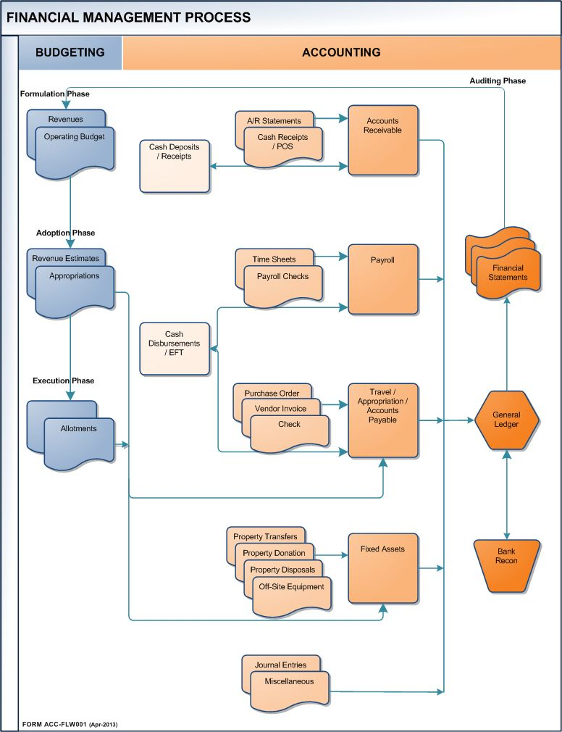

Slide 3

Unposted Transactions
Found in Appendix 1
Viewing Rejected Transactions

Slide 4
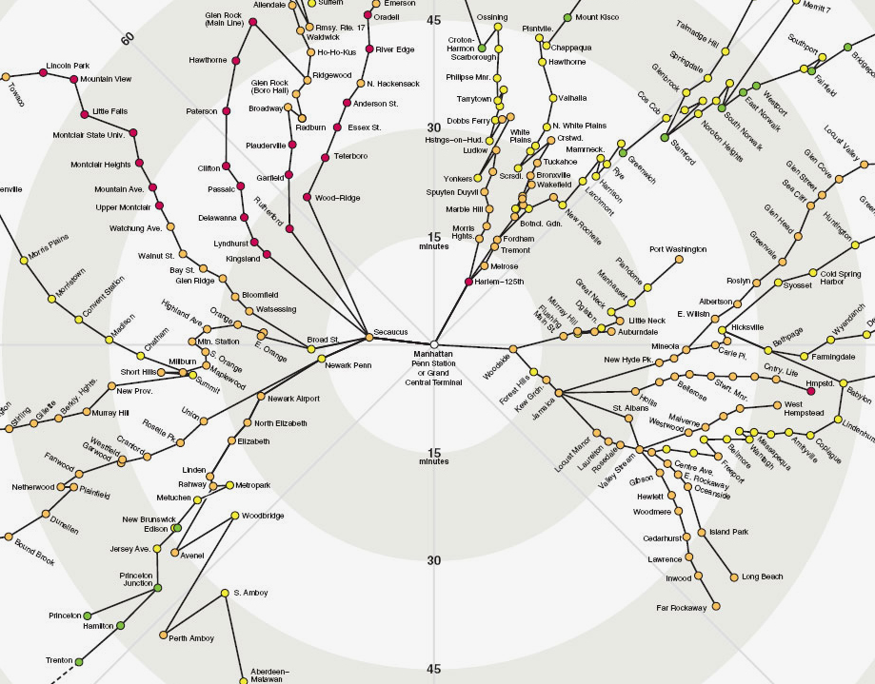
DATA ENTRIES
Unposted Transactions
CENTRAL PROCESSING
Notes:
This is Barcelona, Spain… like almost any major city around the world, travel involves various interconnections which can all start at one point.
Using this sample, we can see a spider-web-like connection of transportation highways and byways. At the center is the main transportation depot, or central station. From that depot, you can take various connected highways to other primary, then secondary passages.
The Financial Management System is similar to this map in that there is the main module with several separate, yet connected, modules (such as the Payroll or GSA modules). These sub-modules may also have sub-modules (lower levels) of their own. One such lower level module is the Unposted Transactions.
The Unposted Transactions is a “transaction holding area” for all processes that affect the accounts in the FMS. ANY transaction data entry – whether they are requisitions, purchase orders, invoices or even journal vouchers - WILL ALWAYS “makes a pass” thru this area before proceeding to their respective destination(s). One exception is the Fixed Assets (refer to the Flow Chart in the beginning of your handout).

Slide 5

Unposted Transactions
Transactions that delay closing processes
Results of Unposted Transactions
  Delays Quarter-end and Fiscal Year-End Financial Reports
  Erroneous statement of funds availability
Causes for Unposted Transactions
  Human Error
    Data Entry Error (i.e. Duplicate entry, Illegible writing/Guesses…)
    Review of Account’s Funds Availability and/or Current Status
    Review of Encumbrance Posted
  Technological Error
    Account Established but Outdated
    Unexpected Glitches
    Internal Control (i.e. Running of Payroll)
    Delay in processing caused by .. Unposted transaction(s)
Notes:
There are several causes for Unposted Transactions.
Unposted Transactions may have more than one error to it too.
Here are the most common ones.

Slide 6
Unposted Transactions (cont’d)
Transactions that delay closing processes
Causes for Unposted Transactions
  Other Issues
    Processing of Vendor Payments
    Transition between Fiscal Years
Important Side Notes
  Accounting Intervention may be needed (no guarantee)
    Assistance with Current Year Purchase Orders:
      When requested directly by GSA Buyers or management; or,
      When approved in writing by GSA personnel.
    Correction of fields in Requisitions:
      Only possible by the assistance of Data Processing, as requested or recommended by GSA personnel.
Notes:
There are several causes for Unposted Transactions.
Unposted Transactions may have more than one error to it too.
Here are the most common ones.

Slide 7
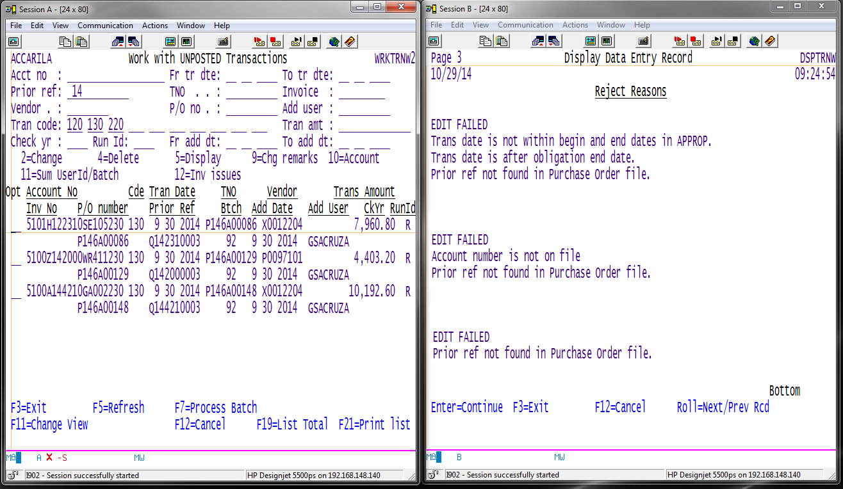
Notes:
These are the most common examples of Unposted Transactions.
P146A00086 – Related to the a) Transaction Date and b) Prior Reference not on file.
P146A00129 – Related to the a) Account non-existent and b) Prior Reference not on file.
P146A00148 – Related to the a) Prior Reference not on file.

Slide 8
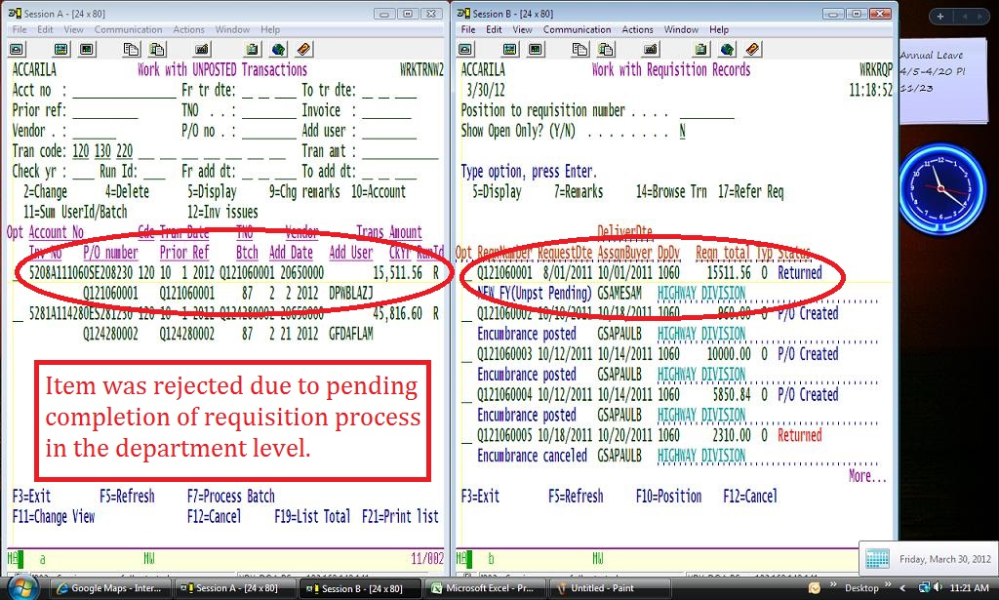
Notes:
Here is one example of an error due to … Unposted Transaction..

Slide 9
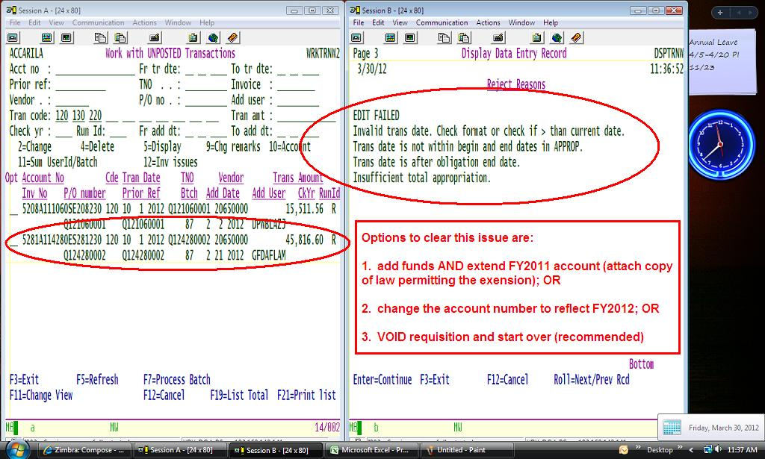
Notes:
Here is one with multiple errors.

Slide 10
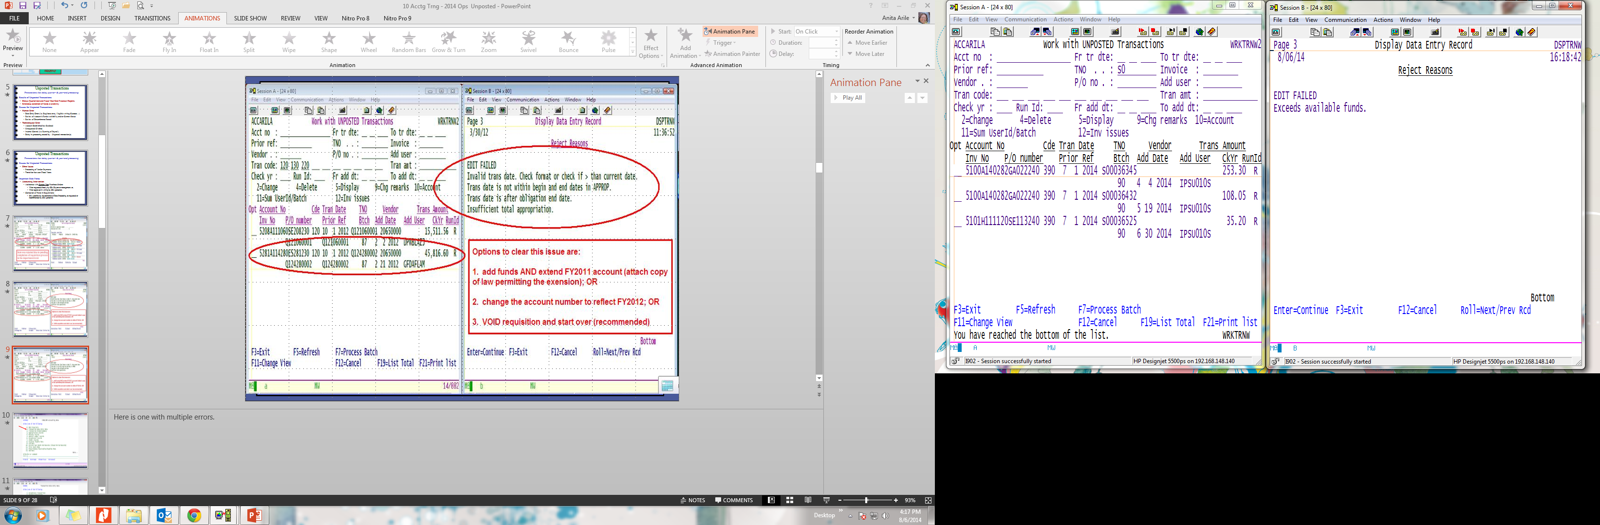
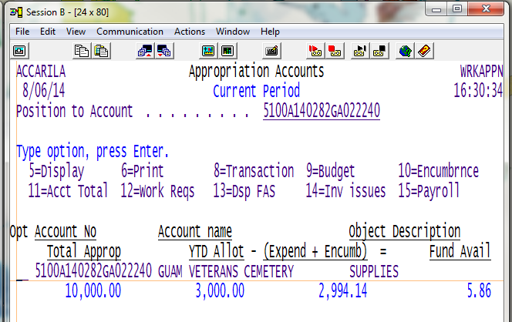
Tenda transactions begin with “S” and typically appear when there is in-sufficient funds or other issues.
Notes:
Here is one with fund balance issue.

Slide 11
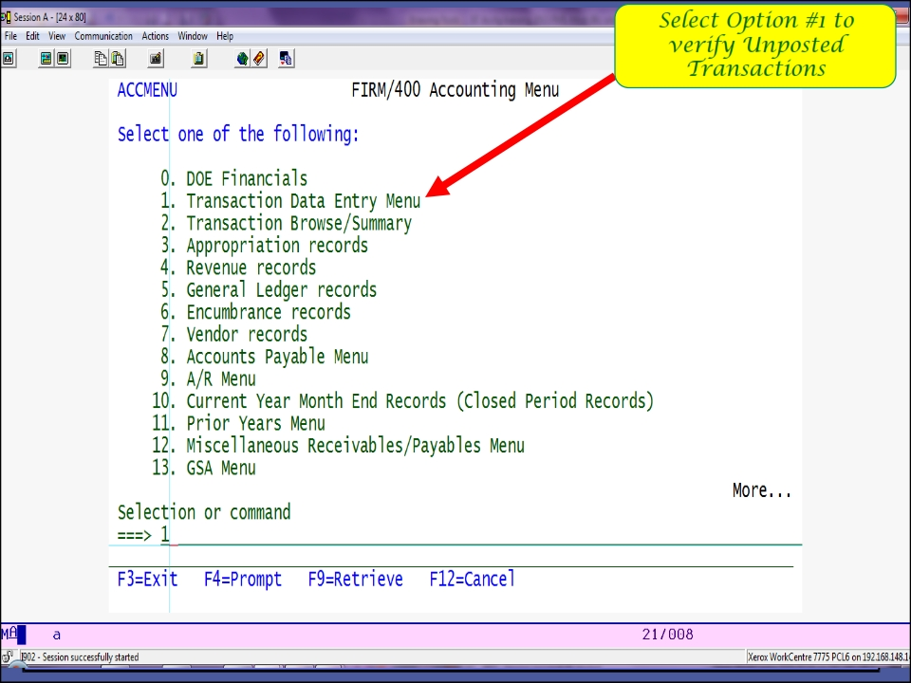
Notes:
To find the Unposted Transaction module, you must first have access to the AS400 Menu Number 1 (Transaction Data Entry Menu).

Slide 12
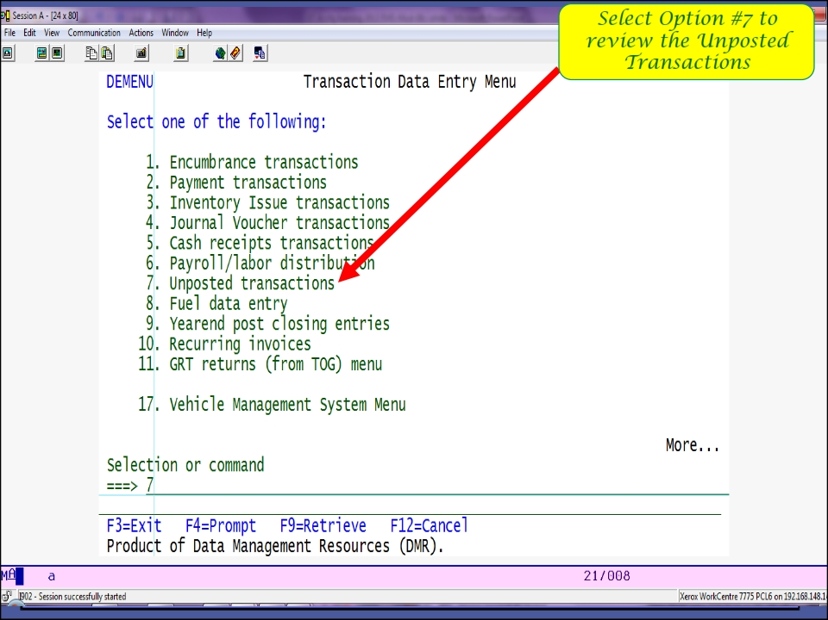
Notes:
In the Transaction Data Entry Menu, you will see the Item Number 7. This is the Unposted Transaction module.
Again, you must have pre-approved access to this module.

Slide 13
Sample One: Amount In Error
Unposted Transactions

Slide 14
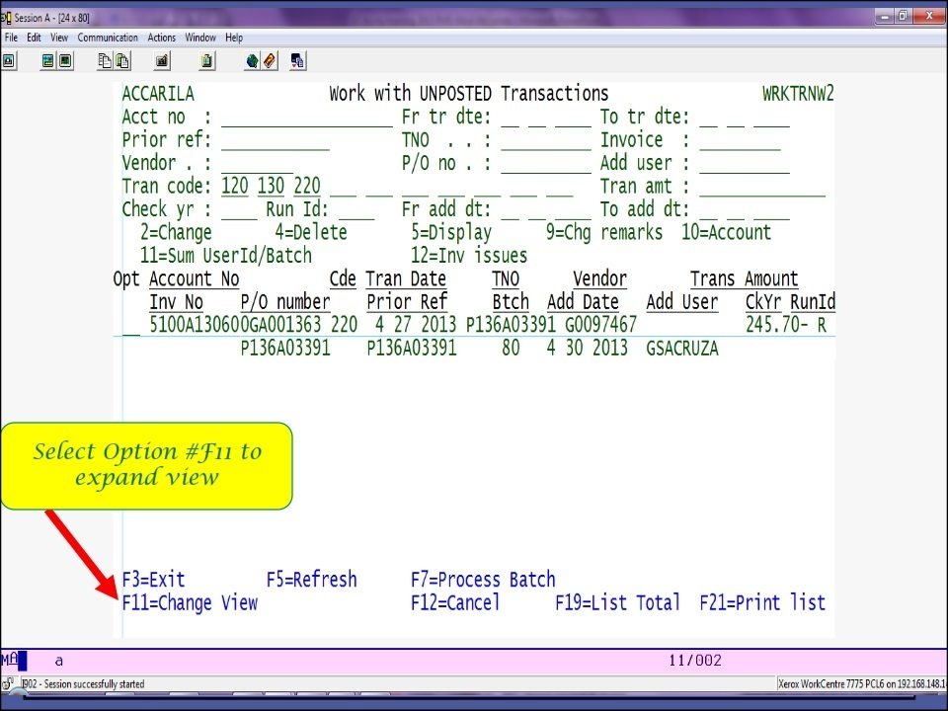
Notes:
Every so often, especially during Report Closing periods (i.e. Quarter-end Closing), the need to “clear out” the Unposted Transactions becomes a priority.
Lingering Unposted Transactions delay the closing of the “books”.
In this example, first glance implies that a Deobligation (or Liquidation) process encountered an error resulting in a rejected attempt to post (the transaction).

Slide 15
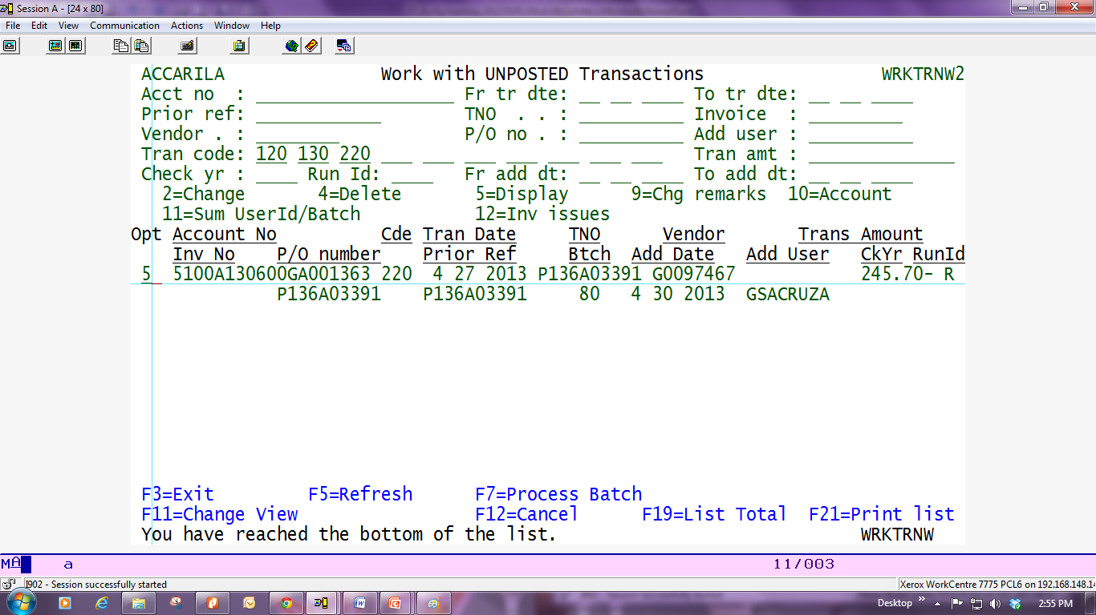
Select Option “5” to display

Slide 16
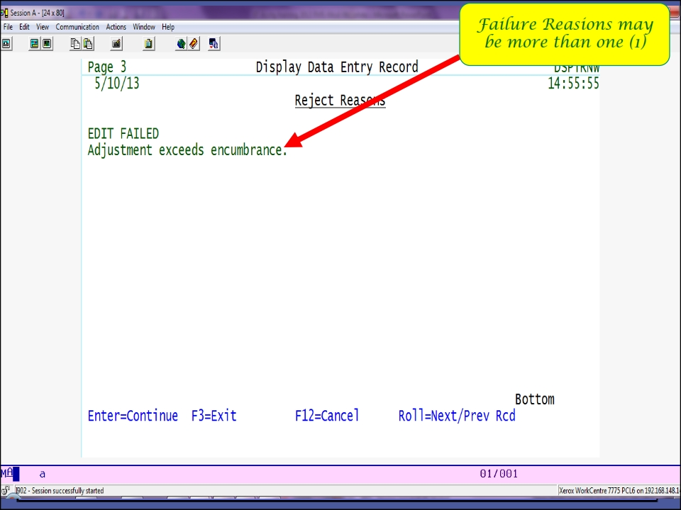
Notes:
Further review reveals the reason for the rejection of the data entry.
In this sample, the adjustment amount of ($245.70) may have exceeded the actual balance of the encumbrance (PO#P136A03391).
Several assumptions can be determined:
Insufficient Funds; or,
Data Entry error; or,
Other underlying issue.

Slide 17
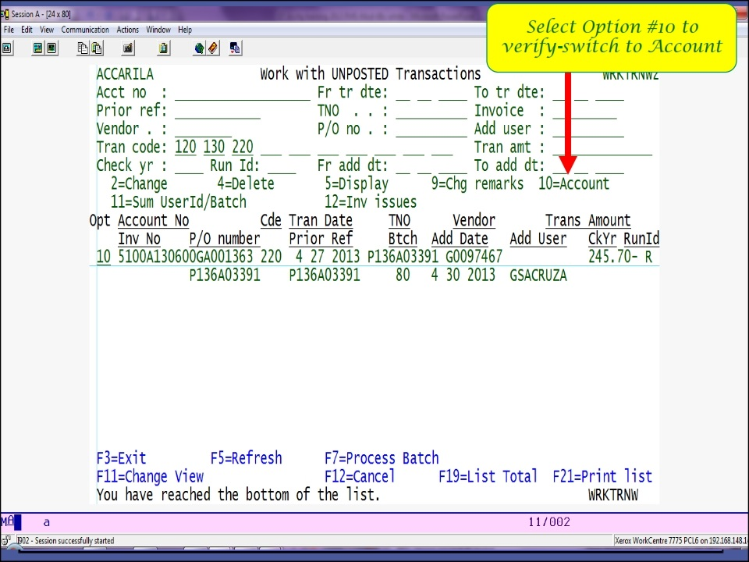
Notes:
Review to verify Funds Availability and Account Information begins

Slide 18
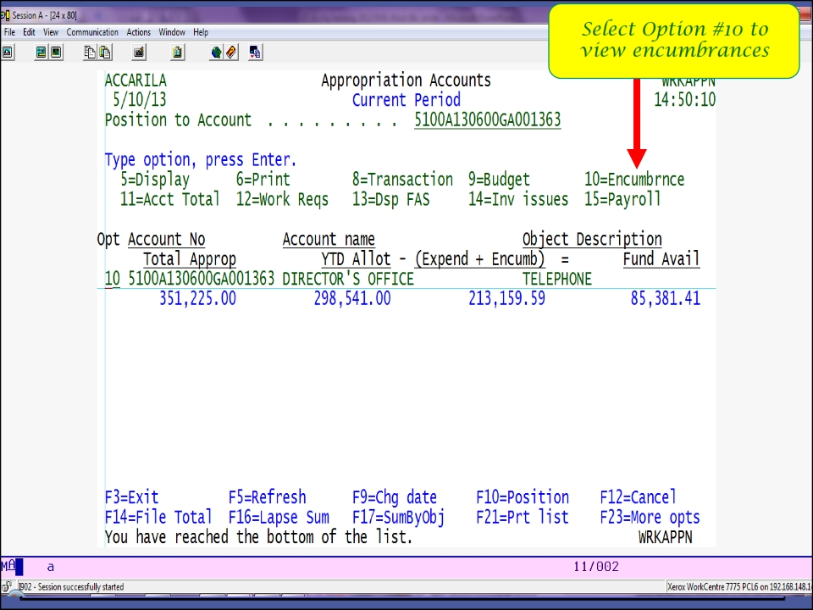
Notes:
Review of the Funds Available resulted in positive values. This finding eliminates the “Insufficient Funding” assumption.

Slide 19
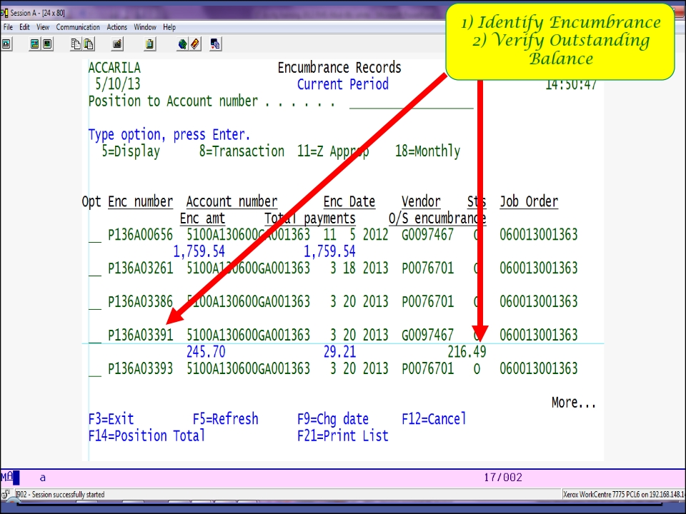
Notes:
Further review into the ACTUAL Encumbrance (PO) Balance revealed a Lower Balance Remaining in the PO#P136A03391.
This finding eliminates the “Other Underlying Issue” assumption.

Slide 20
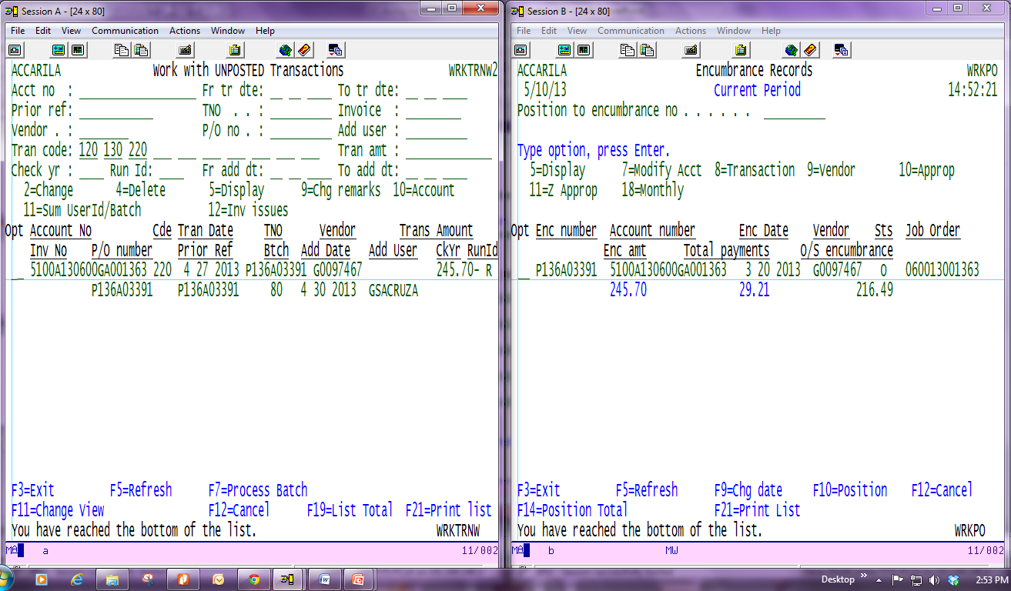
Resolution: Amount being deobligated MUST match actual balance in encumbrance
Notes:
To resolve this sample, the Unposted Transaction amount must be adjust to the lower amount of ($216.49), which is the Actual PO Balance.
Keep in mind that As Long As the Actual Balance is LOWER THAN the Erroneous Entry amount, there will be no need for additional approval.
However, IF the Actual Balance of the Encumbrance is HIGHER THAN the Erroneous Entry, then further clarification and/or approvals are needed.

Slide 21
Sample Two: Account In Error
Unposted Transactions

Slide 22
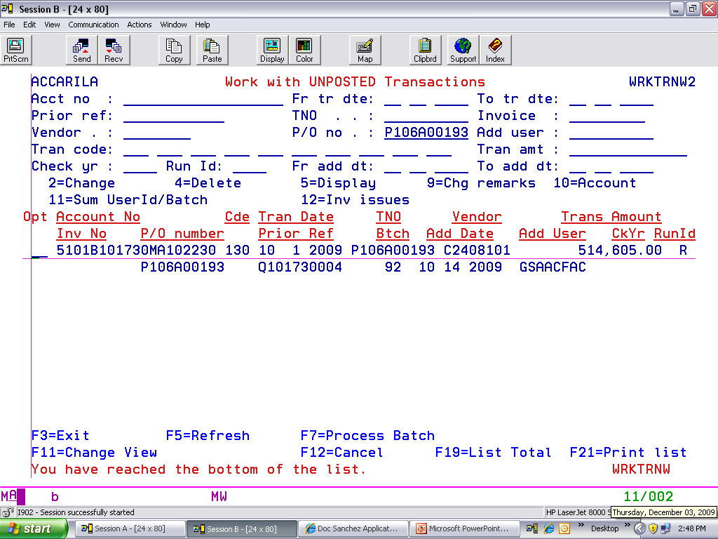
Error: Encumbrance rejected due to Insufficient Funding & Account Does Not Exist.
Notes:
In sample two, the Encumbrance was rejected due to NSF and Account does not exist.

Slide 23
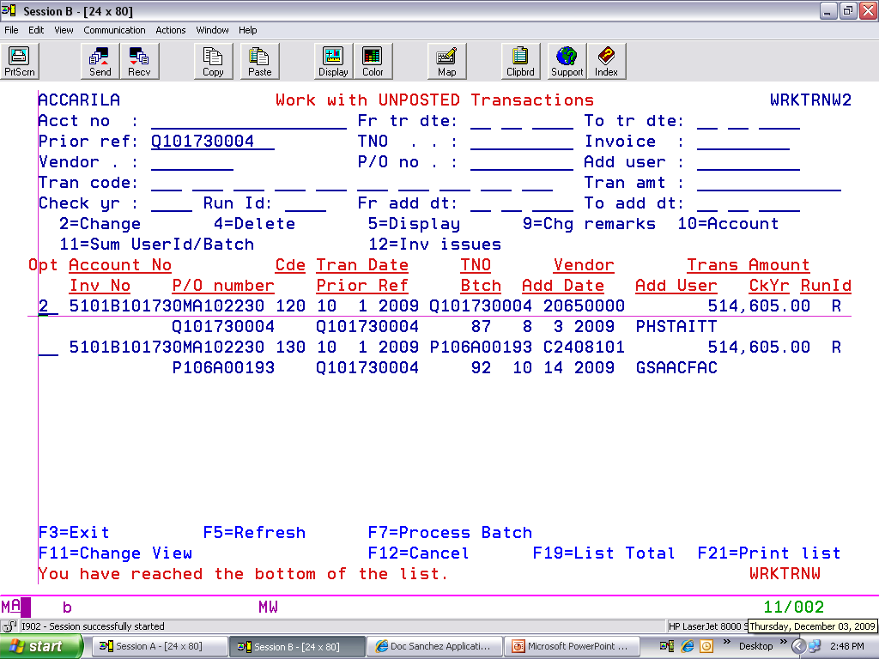
Resolution: Department contacted to verify account information.
For this example, account number is to be changed
Notes:
Because BOTH the Requisition AND Purchase Order were rejected, the Department must be contacted to resolve this issue immediately.
When a requisition is rejected, any attempt to utilize its funding would result in a rejected purchase order. This is a Control Process that will prevent the creation of a Purchase Order from an Insufficiently funded or non-established account Requisition.
It also represents human error.

Slide 24
Correcting Unposted Transactions
Unposted Transactions

Slide 25
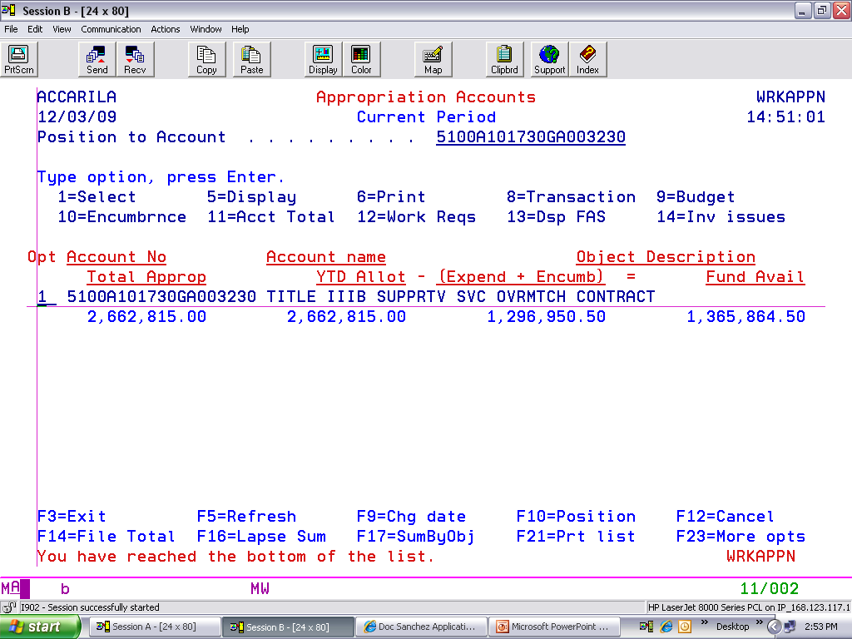
Dept provides the Correct Account No.
Verify if there is Sufficient Funding
Notes:
Upon receipt of the “recommended” account number to utilize (from the Department), the account number is Verified for Current Status and Funds Availability.

Slide 26
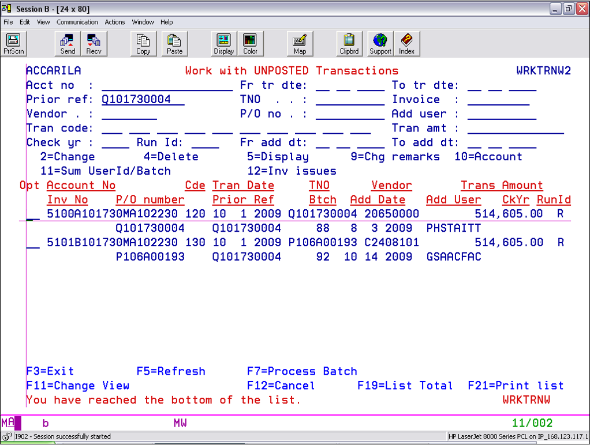
Select Item to Correct;
Then. note TNO information
Notes:
Because BOTH the Requisition AND Purchase Order were rejected, the Department must be contacted to resolve this issue immediately.
When a requisition is rejected, any attempt to utilize its funding would result in a rejected purchase order. This is a Control Process that will prevent the creation of a Purchase Order from an Insufficiently funded or non-established account Requisition.
It also represents human error.

Slide 27
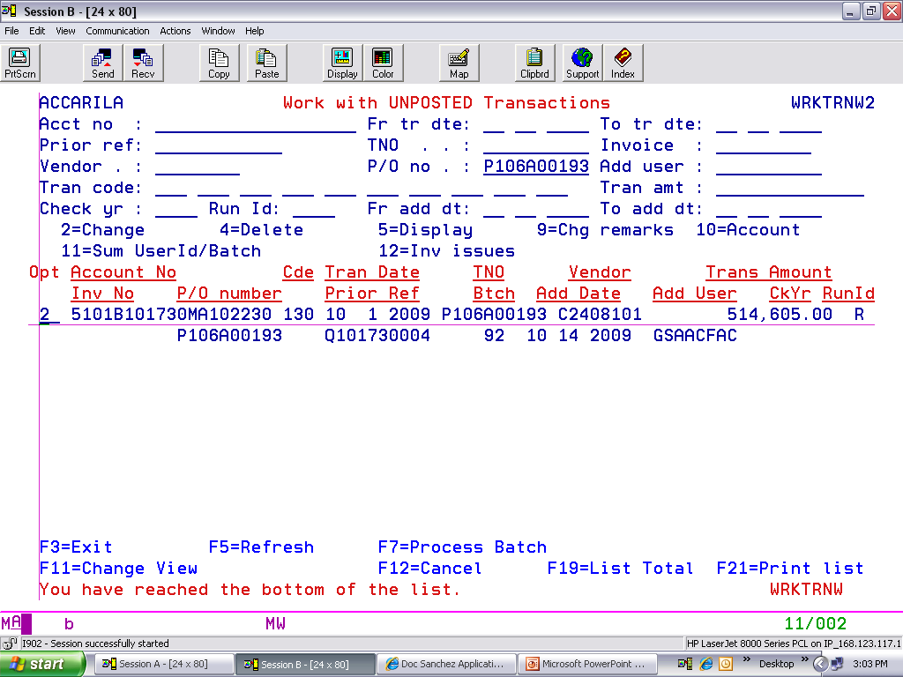
Enter TNO to update
Notes:
After the Requisition is processed, ONLY THEN will the Purchase Order be able to be completed. This is because the initial reservation of funds was done through the requisition. When the final reservation (aka award to a vendor) is approved, THEN the value will be “extracted” from the requisition for encumbrance as an approved Purchase Order.

Slide 28

Select Option “10” to verify encumbrance
Message will indicate successful update
Notes:
Once the account has been corrected, the transaction should be processed.

Slide 29
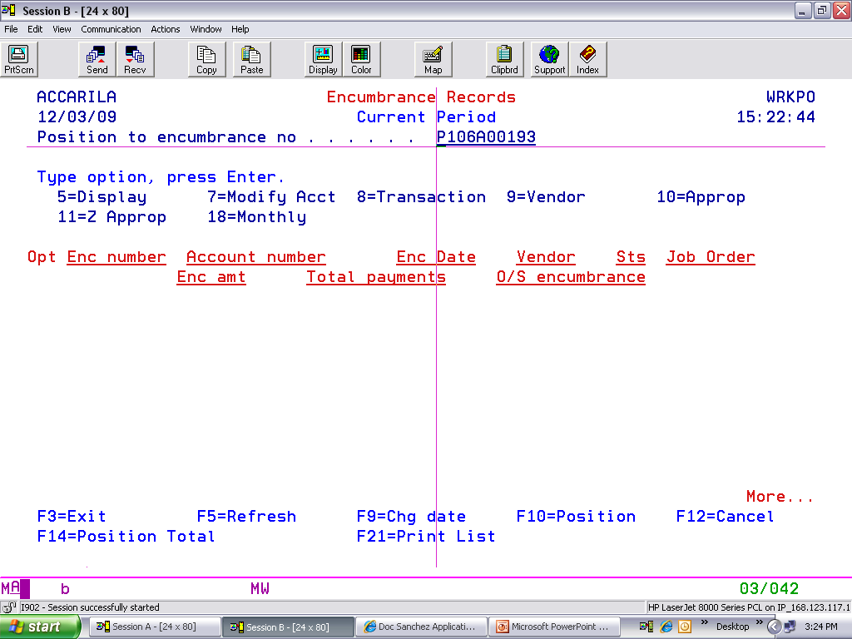
Type in the Encumbrance Number
Notes:
After processing of the Requisition and Purchase Order, verification of completeness is next.

Slide 30
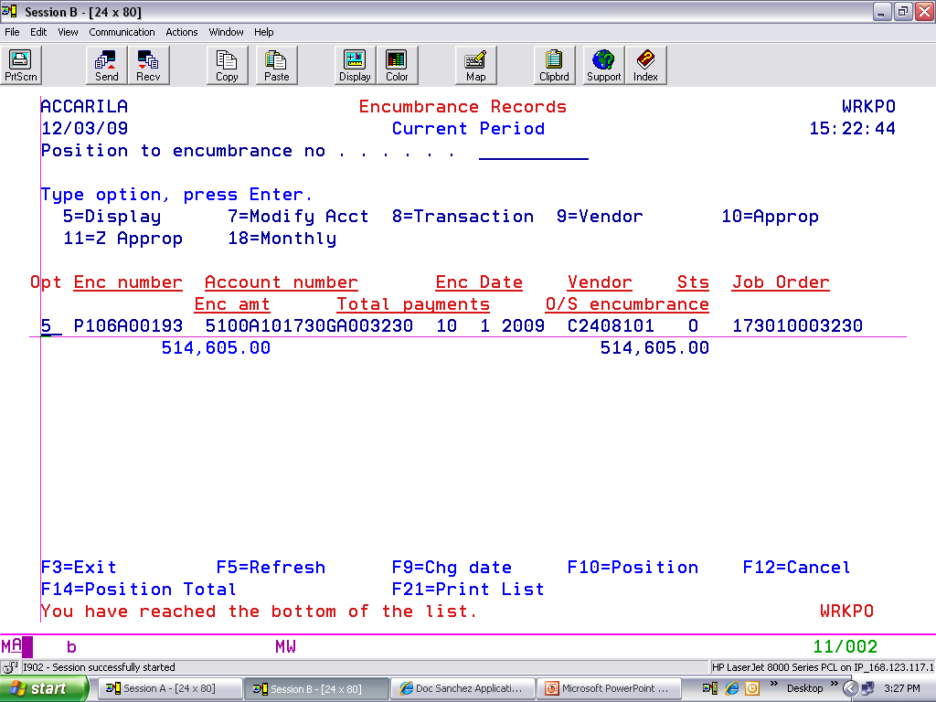
Verify the account information
Notes:
COMPLETE!

Slide 31

Select option to correct remaining encumbrance
Notes:
To correct this type of error, after verification of funds availability and current status of an account, the Requisition MUST BE Corrected and Processed First and Separately from the Purchase Order utilizing it for encumbrance.

Slide 32

Verify all adjustments for correctness
Notes:
To correct this type of error, after verification of funds availability and current status of an account, the Requisition MUST BE Corrected and Processed First and Separately from the Purchase Order utilizing it for encumbrance.

Slide 33

QUESTIONS…?
Anita.Arile@doa.guam.gov
475-1115

